Slide 1






PRESENTATION 2026
Project Title: Closing the Feedback Loop: An Intelligent Student Feedback Analyzer & Teaching Improvement Advisor (Let’s Call it “IXA”)
Mentor Name
Faculty Email
Faculty Name
Adarsh Sir
payal.shastri@hlcollege.edu
Dr. Payal Shastri

Slide 2

Outline
Abstract of the Project
Problem Statement
Proposed Solution
System Architecture
Live Demo of the Project
Embedded Video of Project
Conclusion
Future Scope

Slide 3
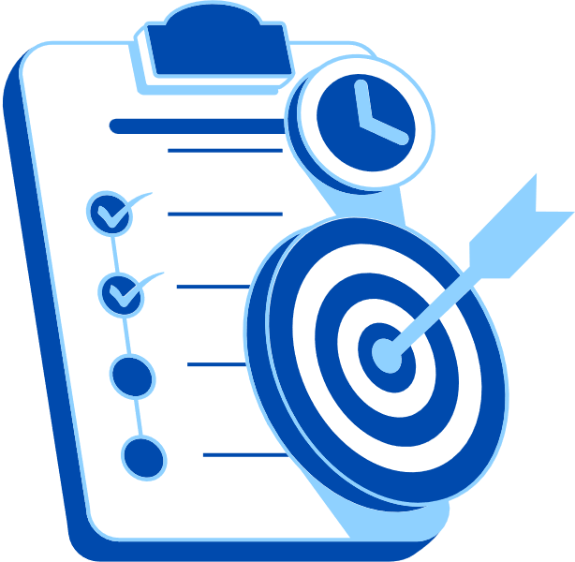
Abstract
End-to-end Faculty Feedback and Analytics System
Data: 200 responses | 8 faculty | 3 courses | 10 parameters
Objective: Convert raw feedback into actionable academic insights
Approach: Data analytics + AI-driven interaction
Tools: Excel dashboards + Copilot Studio chatbot
Outcomes: Interactive insights, plain-language query responses, personalized faculty improvement plans (up to 30 days)
Highlight: Integrated Excel + AI smart architecture

Slide 4

Problem Statement
Core Problem
Feedback data scattered & underutilized
Qualitative comments ignored at scale
No tools to extract meaningful insights
Excel-based storage with no visualization
No linkage to faculty improvement planning
Why It Matters
Weak faculty unsupported; strong faculty unrecognized
Teaching quality stagnates across semesters
Impact Gaps
For HODs & Management: Dimension-wise faculty feedback
For Admin: Data-backed evidence for submitting reports
For Accreditation Bodies: Transparency and detailed structured analysis
For Faculties: Feedback as well as Analyzer for Improvements

Slide 5

Proposed Solution
THE SOLUTION:
INTELLIGENT THREE-TIER ANALYSTICS SYSTEM
Tier 1 – Excel Analytics: Pre-processed dataset for faculty performance matrix, course-wise scores, year-wise and semester-wise comparison tables with delta indicators
Tier 2 - AI Chatbot (Copilot Studio): INFORMATION MODULE – Natural language agent trained to answer both quantitative queries (scores, rankings) and qualitative queries (comment summaries, sentiment breakdowns).
Tier 3 - AI Chatbot (Copilot Studio) – COACHING MODULE: The bot after highlighting weak areas, automatically asks for improvements suggestions and delivers specific, classroom-ready improvement strategies extended for 30 days.

Slide 6
System Architecture
Data Input / Source
Processing / Analysis
200 student feedback responses (CSV), Excel workbook –10 quantitative score, Qualitative student comments with sentiment labels, faculty name, type of faculty, type of courses - B.Com, BBA, BCA, two years, and four semester.
Data cleaning and Custom column: Average_Score across all 10 dimensions; Sentiment classification: Positive / Negative tagging; Comment categorisation across 13 categories and all dimensions; Year-wise and semester-wise delta calculations (Δ scores) for comparison.
AI / Tool Integration
Output / Dashboard
Microsoft Excel - interactive dashboard; Microsoft Co-pilot Studio - AI conversational agent
3 CSV knowledge sources uploaded to Co-pilot Studio
for creating Coaching layer: weak area detection + suggestion engine.
AI Chatbot: natural language answers to any feedback query.
Faculty coaching: personalised 30-day improvement plans.
Export: PDF snapshots + Power BI Service shareable link
Audience: faculty, admin, students, external stakeholders

Slide 7
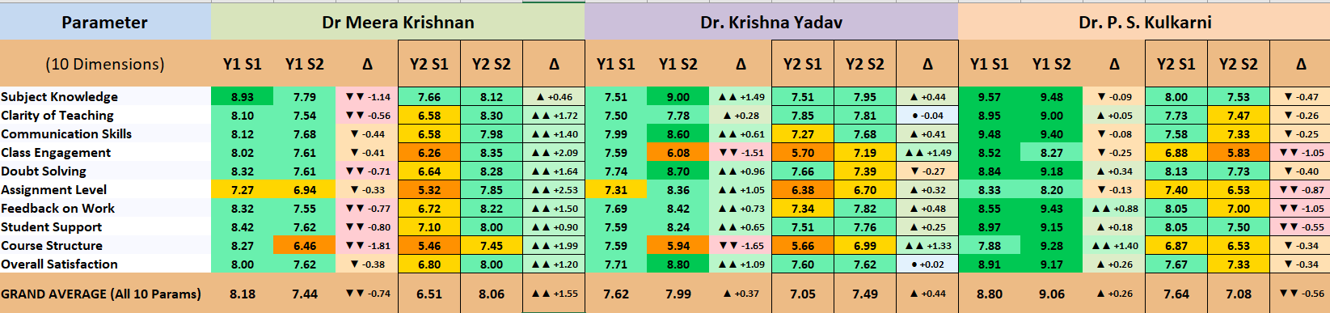
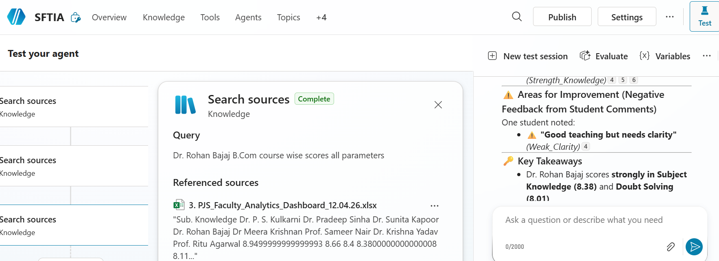
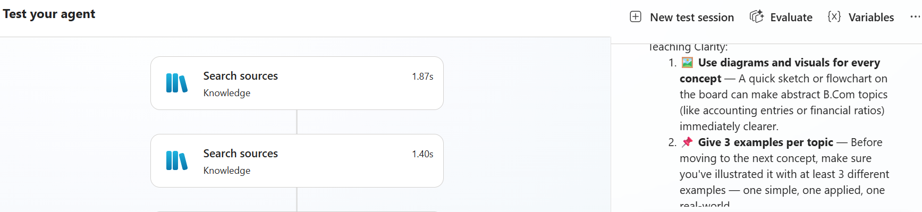
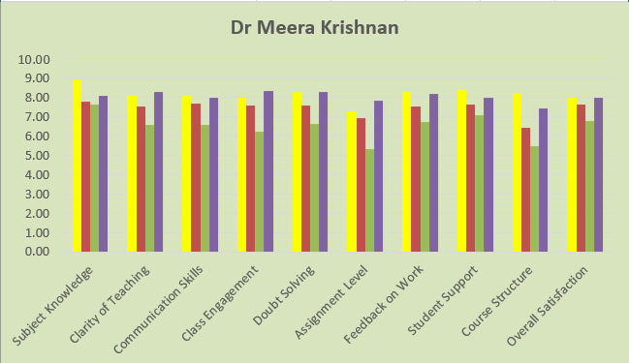
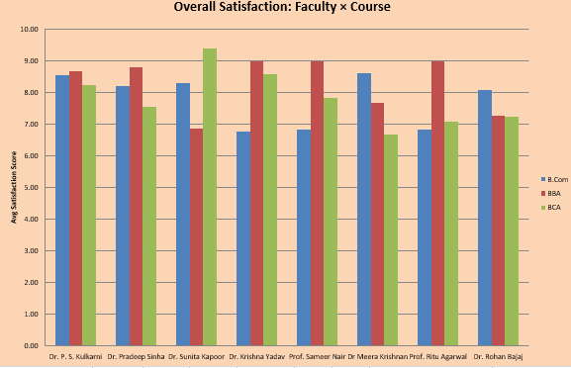
Live Demo of Project
Here's the list of some demo screenshots / features of the project:
Excel Dashboard
Interactive AI-Chatbot
Suggestive
AI-Chatbot
Demo 1
Demo 2
Demo 3

Slide 8
Video of Project Demo
[https://your-project-dehttps://drive.google.com/drive/u/0/folders/1pug4VwyevA-ifJPqKeYiVGvgt9WsZvAEmo-link.com]
▶
[Insert your project demo video.
You can embed a video your live project.]

Slide 9

Conclusion
The key findings of this project is successfully designed & deployed a complete end-to-end Faculty Feedback Analytics System.
Excel dashboard with visual insights of faculty performance – QUALITATIVE AND QUANTITATIVE PATTERS, across the all semesters and years for all faculties and all courses.
AI chatbot agent – answering questions seamlessly for both quantitative & qualitative feedback queries in plain English, FOR ALL STAKEHOLDERS with or without any technical knowledge.
First-ever faculty coaching module – giving feedback identifying weak dimensions and delivering personalized, evidence-based improvement strategies to faculty and also help with 30-days strategy plan development.

Slide 10

Future Scope
Real-time feedback Integration: Connecting live Google or Microsoft Form directly into the Excel Dashboard and /or Power BI dashboard and chatbot without any manual CSV export.
Multilingual chatbot support: AI agent to accept and respond in regional languages: Hindi, Gujarati, etc. making it accessible to a broader range of stakeholders across institutions.
Voice-enabled chatbot: Speech-to-text so faculty can verbally ask feedback questions – for hands-free and accessible on mobile devices

Slide 11
Thank You
Any Questions?
AICW Fellowship | Student Project Presentation 2026
LinkedIn | Edunet Foundation

